Slide 1
ATDI Overview
Presented by: Amanda Bredstrup
APCO – AFC
Senior Processor
National Regional Planning Council

Slide 2
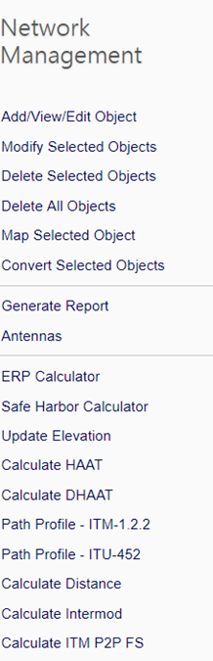
Overview of Network Features

Slide 3
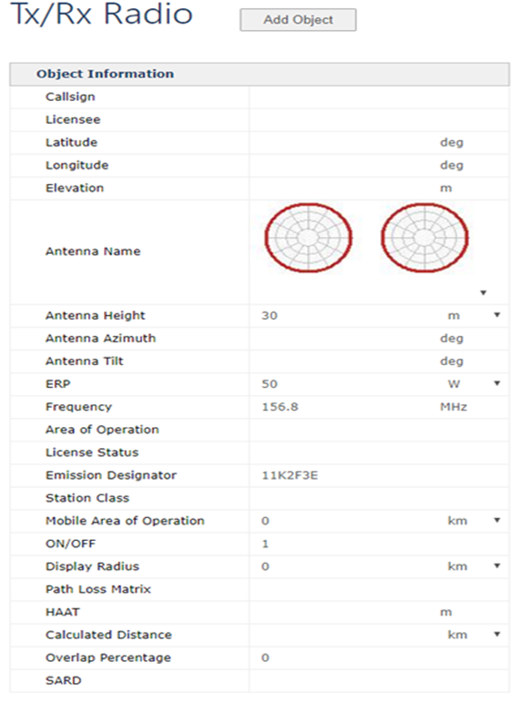
Add/View/Edit Object
This feature allows you to add, edit or duplicate sites in your network. The screen shot on this slide shows the scree to add a new site. You can use decimal or degree, minutes, seconds format to add sites.

Slide 4
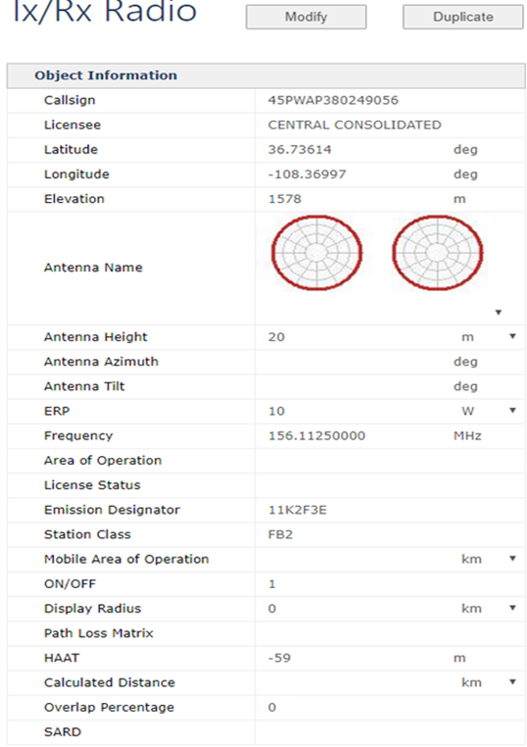
Add/View/Edit Object continued
This screen shot shows the edit or duplicate option.
You can modify any of the fields on this screen. This is where you would add antenna patterns, mobile area of operation….
You can also duplicate a site if needed.

Slide 5
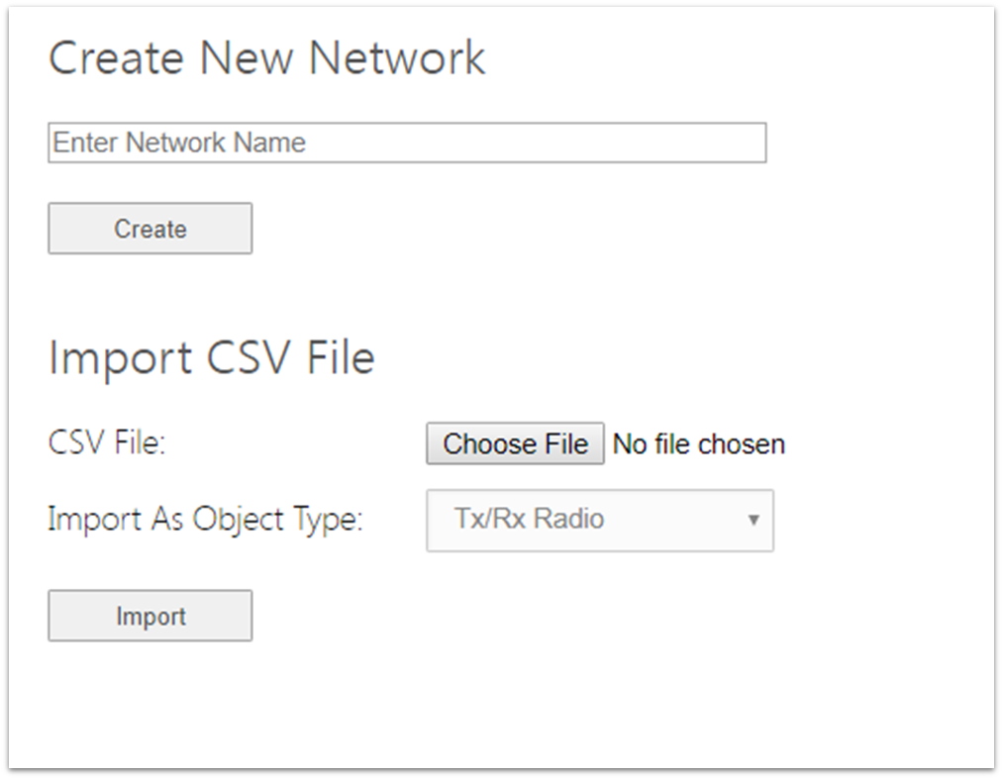
Importing CSV file
The CSV importation mechanism is located on the My Networks page under the Home umbrella page. The Choose File button is used to choose the appropriate file on the user’s computer while the Import As Object Type drop-down menu allows the user to select the appropriate object type to import the objects from the CSV file as.

Slide 6
Importing CSV file continued
A specific file format must be followed for the importation procedure to execute properly. The individual objects are to be arranged in rows with specific column headers that define the parameters to be imported. The columns do not have to be in any particular order and not all parameter types have to be used, though the column headers do have to be labeled thus:
Station callsign (text) – callsign
Licensee (text) – licensee
Latitude (DEC or DMS) – latitude
Longitude (DEC or DMS) – longitude
Elevation (meters by default) – elevation
Antenna name/type (exact file name of antenna from user’s antenna directory)– antenna_name
Antenna height (meters by default) – antenna_height8
Antenna azimuth (degrees) – antenna_azimuth
Antenna tilt (degrees) – tilt
Radiated power (Watts) – erp
Frequency (MHz by default) – frequency
Emission designator (text) – emission

Slide 7
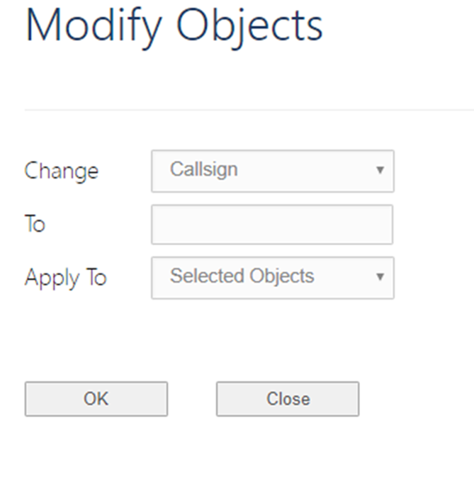
Modify Selected Sites
This feature allows you to modify multiple sites at the same time. This only works if the value will be the same at all selected site.
There are many options that you can change here like, ERP, Antenna, Display radius….

Slide 8
Delete objects
You have two options to delete objects
Delete selected objects. This is just as it sounds any objects that are selected will be deleted.
Delete all objects. This option will delete all objects in the open network.
Once an object is deleted there is no way to retrieve it. You will have to import or enter it again.

Slide 9
Map selected object
Once you have entered your sites you can center the map on one of the sites by selecting it then clicking Map Selected Objects.

Slide 10
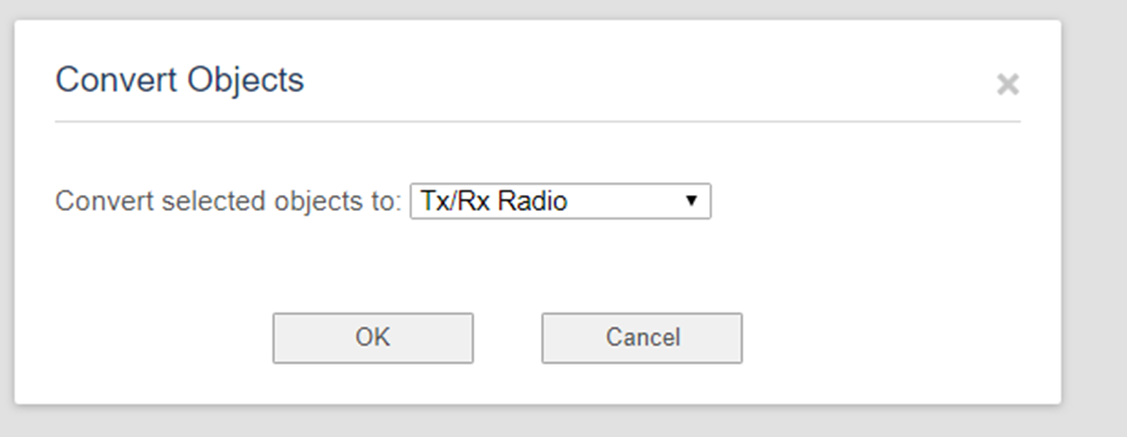
Convert select objects
There are five object types; Tx/Rx, Incumbent, Area, Text, and Line. You can move your objects between these options by selecting them and clicking on Convert Selected objects. The box below will appear were you can choose where you want it moved.

Slide 11
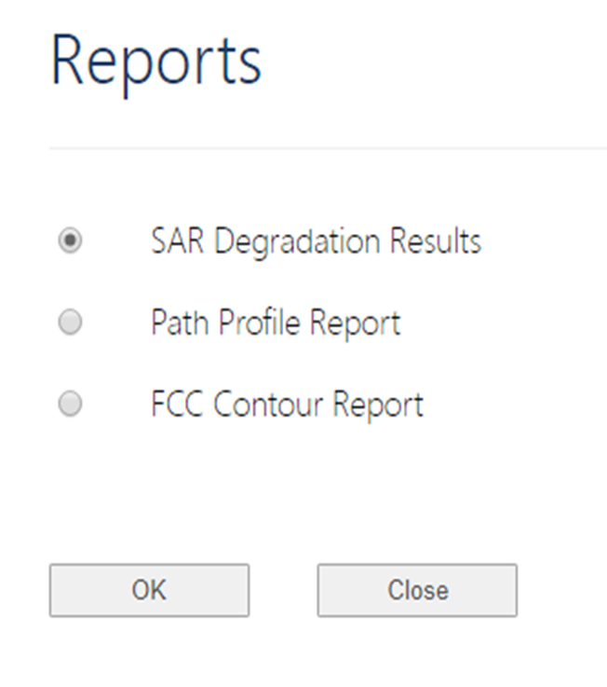
Generate Report
ATDI has three reports you can create from the network page.
SAR Degradation Results: This will show the map and a list of the SAR results at the bottom of the page.
Path Profile Report: Will show the path between to points. Results will show; line of sight, path distance, free space loss and ITM path loss.
FCC Contour Report: This report will show the map and a list of the sites and technical info below the map.
The results will show the last image on the map page. If you make changes after looking at the map be sure to go back to the map page to ensure the correct image is shown.

Slide 12
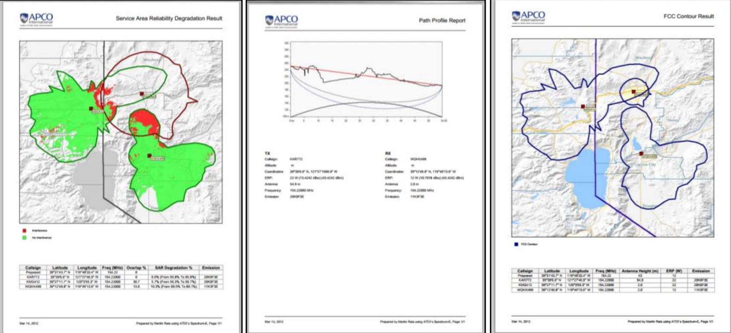
Generate Reports continued

Slide 13
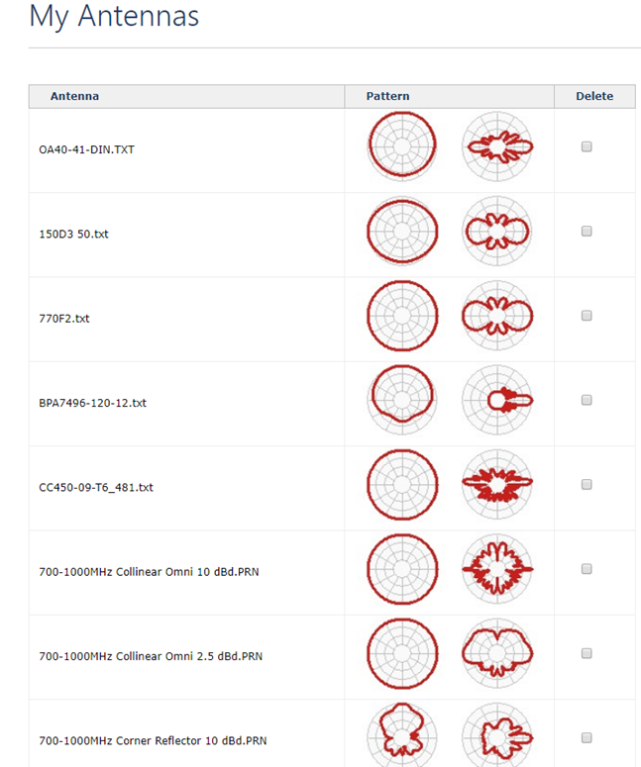
Antennas
This page lists all of the antenna patterns you have saved in your system.
You can delete and add antennas here.

Slide 14
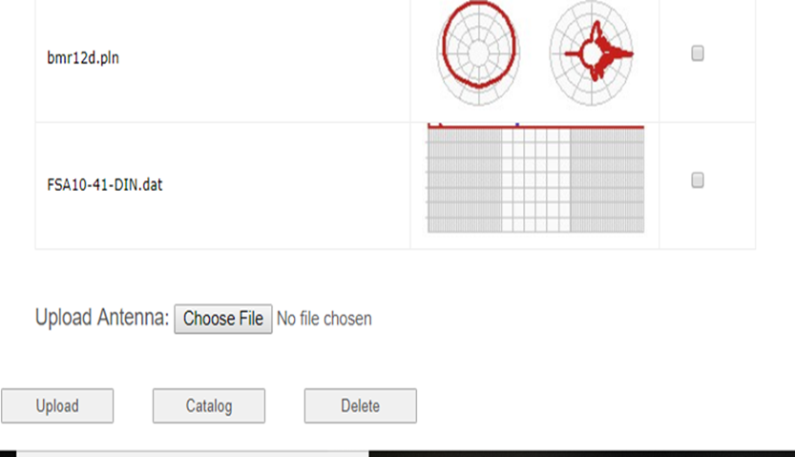
Antennas continued
To add new antennas click choose file, find the antenna in your documents then click Upload.
To delete antennas select the box next to the antenna and click delete.
The catalog button will give you a list of all of the antennas in your system

Slide 15
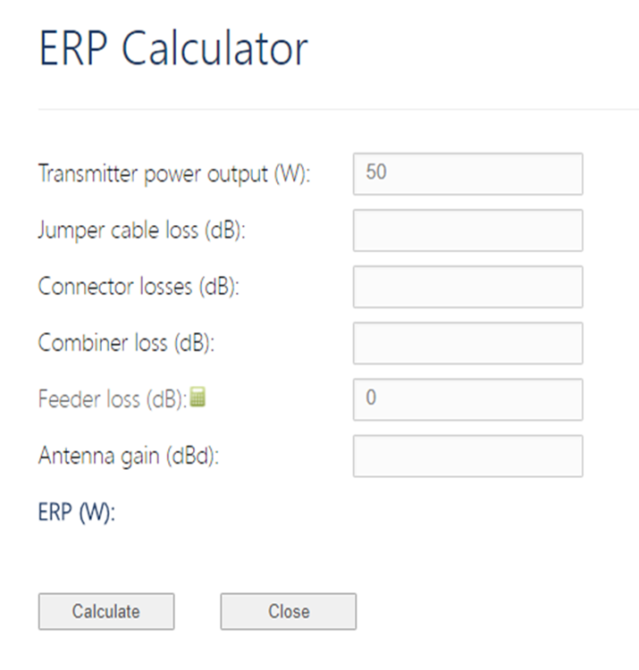
ERP Calculator
The ERP calculator allows you to add the required information needed to calculate ERP for a site.
The green box next to Feeder loss opens a Cable loss calculator.

Slide 16
Calculate HAAT
Use this function to calculate or confirm Height Above Average Terrain (HAAT).
We are required to calculate HAAT when doing coordination. If it differs from what is provided by applicant we must notify them of the change. We do not change sites that are currently licensed and not making changes.

Slide 17
Path Profile
This function allows you to generate a path profile between two objects. Select two objects and click Path Profile.
It is limited to 250 km distance separation.
Images of the report is in the slide below.

Slide 18
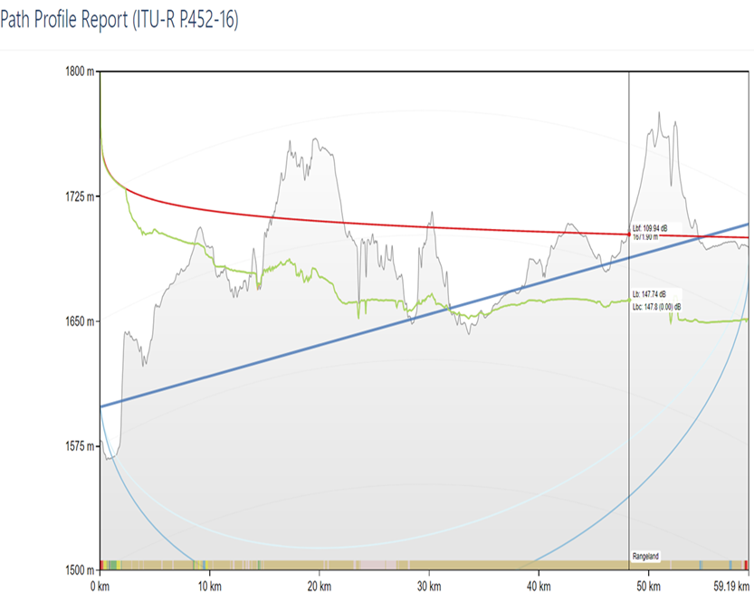
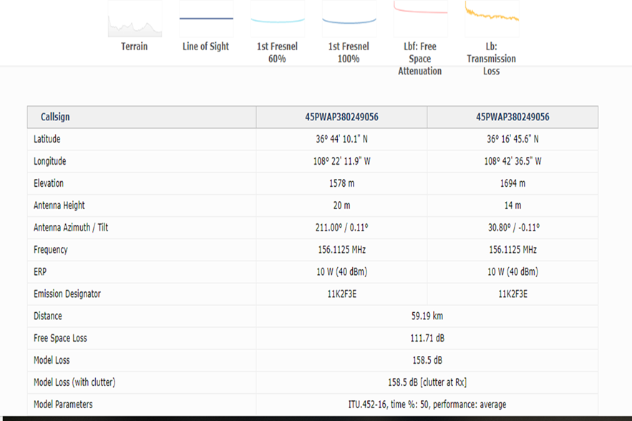
Path Profile continued

Slide 19
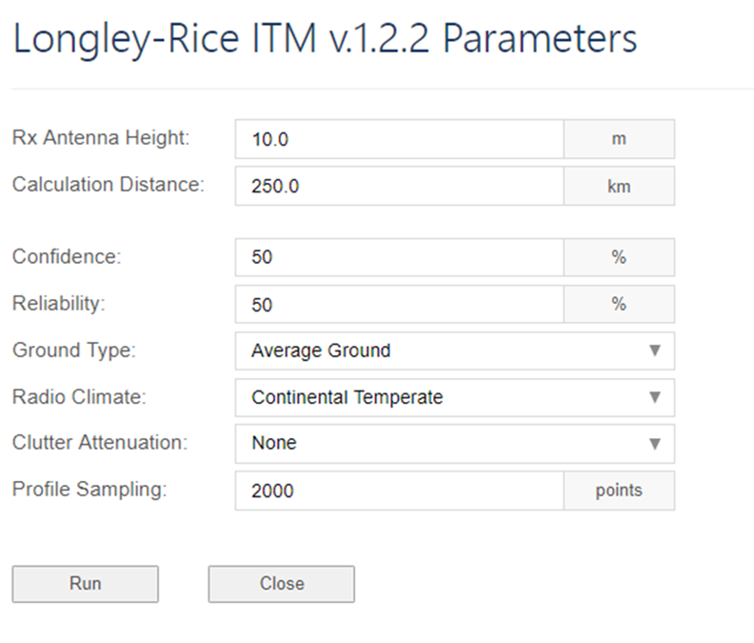
Calculate Longley-Rice
This is one of two path loss matrix available in ATDI. It can be used for TDMA analysis, NPSPAC and other coordination standards.
Select your sites, click on calculate LR, the screen shot shown here will open. You will need to enter the Rx antenna height. The other fields are set to default settings you can adjust if needed.
To get the propagation model you will need to select your site and then choose which Power Received option is needed. There are several to choose from dBm, dBu, and PFD talk out and dBm talk in.
If you want to verify the path loss matrix was run you can scroll to the right and find the information under the path loss matrix field. It will show for any site LR was run on. It will show as ITM (irregular terrain model)

Slide 20
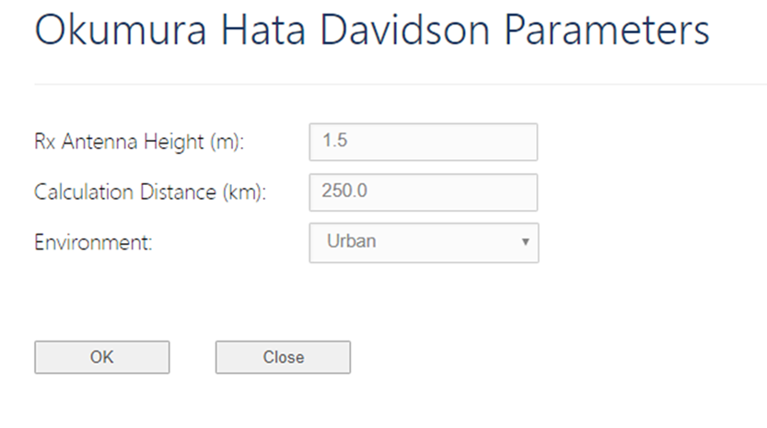
Calculate O-H-D Path Loss
Okumura-Hata-Davidson is the other path loss matrix available in ATDI.
Select your sites, click on calculate O-H-D, the screen shot shown here will open. You will need to enter the Rx antenna height. The other fields are set to default settings you can adjust if needed.
To get the propagation model you will need to select your site and then choose which Power Received option is needed. There are several to choose from dBm, dBu, and PFD talk out and dBm talk in.
If you want to verify the path loss matrix was run you can scroll to the right and find the information under the path loss matrix field. It will show for any site O-H-D was run on. It will show as OHD urban (or whichever environment selected)

Slide 21
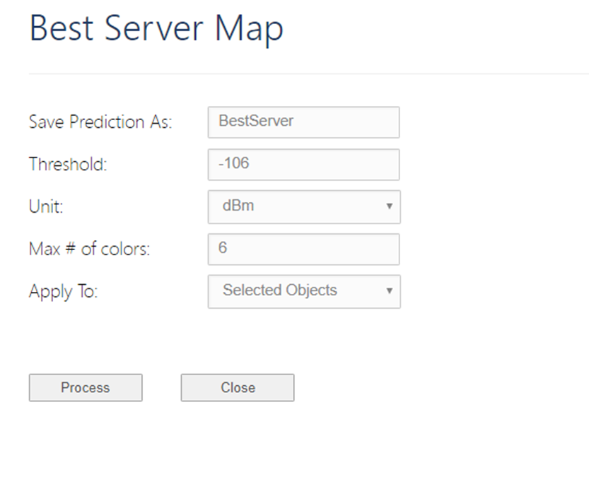
dBm Talk-Out Best Server
Best Server function can be used to create a coverage prediction that shows which station in a group offers the strongest power received.
Once you have run Longley Rice on the desired stations you can select the best server option. The screen shot here will pop up with default settings.

Slide 22
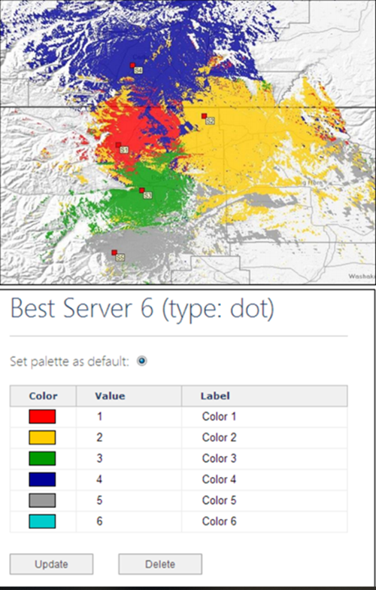
dBm Talk-Out Best Server continued
Save Prediction As allows the user to enter a custom name for the prediction that will be created.
Threshold (dBm) is the minimum value for which a pixel will be considered covered (by any emission that is a part of the analysis).
Max # of colors allows the user to select the maximum number of colors that can be used in the resultant coverage. Colors may be reused for large groups of stations.
Apply to allows the user to apply the function to the selected emissions or to all emissions in the
HINT: It is important to have a compatible palette for the Best Server display. The palette used must have at least 2 values (rows); preferably the palette has the same number of rows as the “Max # of colors” used when the function is executed. A dot-type palette is required. The following example palette has 6 rows and thus uses 6 colors (it is the same palette as used for the coverage prediction example shown above)

Slide 23
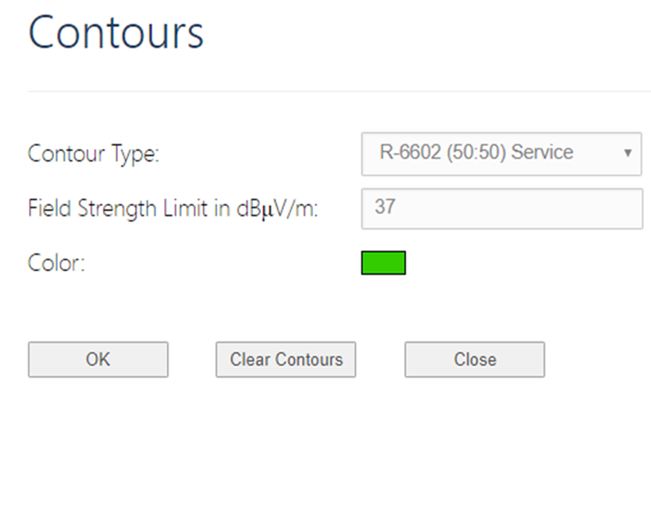
FCC Contour
There are three options for running FCC contours.
1. Generate custom (R6602) contours
2. Generate (R6602) Interference contours
3. Generate (R6602) LMCC Derated contours
Generate custom contours gives you the option to choose what type of contour you want to run, the field strength limit and the color of the contour. You can also delete contours you have already created.
To run the custom contour, select your site(s) click Generate Custom (R6602) contours and select your parameters.

Slide 24
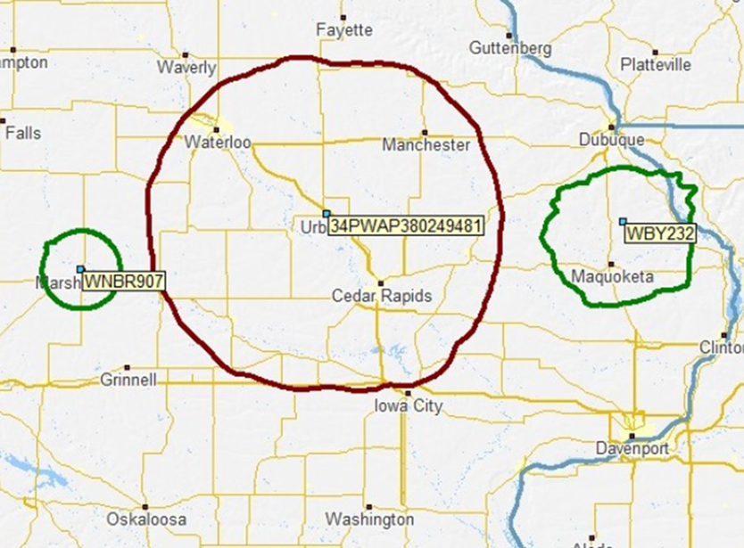
FCC Contour continued
Generate R6602 Interference contours applies the appropriate interference and service contour values to the existing stations in the network list based on their frequencies.
The user must highlight one object in the network list (if multiple are highlighted, the top-most will be taken); this object will be the interferer/proposed station and will have the interference contour befitting its frequency generated for it (40 dBu and 22 dBu)

Slide 25
Calculate TSB-88 C SARD
This function is based on the TIA TSB-88-C methodology for calculating service area reliability degradation. It has two outputs; a percentage and a map overlay. To perform this analysis, there are two prerequisite functions that first need to be completed.
First any station that is to be a part of the analysis, whether it is the proposed interferer or the victim incumbent, requires a path loss matrix to be generated. Longley-Rice or OHD; multiple objects can be highlighted at once to perform the calculation for more than one object.
The second prerequisite function that is to be completed before the use of the TSB88C SAR function is the generation of FCC contours. For this, the user must highlight the proposed station (the interferer) and run the Generate R6602 Interference Curve Contour function. This generates the interference contour for the proposed station and service contours for the victims.
Once these two prerequisite functions are run, the user highlights the proposed station and clicks on the Calculate TSB88C SAR function. Results will show under the SARD column.
To see the result on the map, navigate to the Map page and then select Predictions in the left-hand menu. The result of the TSB88C SAR function is stored under the filename sard_dot. Click on sard_dot in the Existing Predictions table so that it appears as the Current Prediction

Slide 26
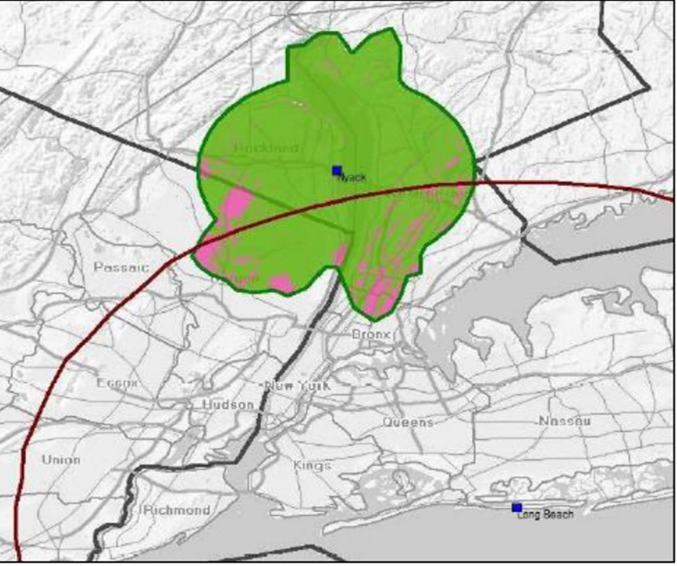
Calculate TSB-88 C SARD continued

Slide 27
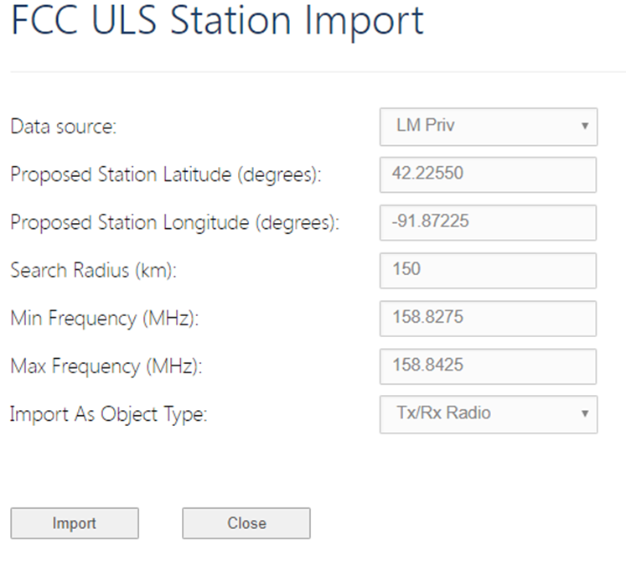
Import FCC ULS LM-Priv
The FCC ULS LM-Priv import function allows the user to import stations from the FCC Land Mobile Private (LM-Priv) Universal Licensing System (ULS) around a central coordinate (or object) out to a given distance, and within a given frequency range.
You can either select a site in your network to base the coordinates and frequency on or you can manually enter them
You can choose to import the list into Tx/Rx or incumbent. It is recommended to import them into incumbent.

Slide 28
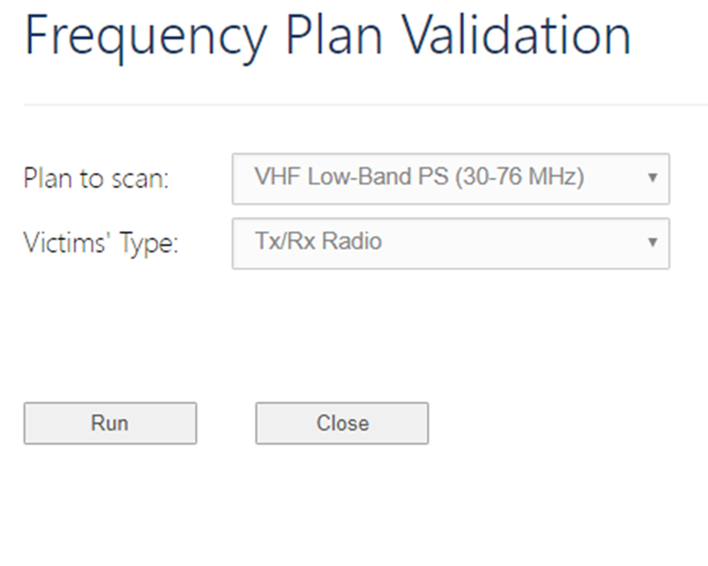
Frequency Nomination
The frequency nomination function is used to find available or ‘best-case’ frequencies for proposed stations or when a new frequency is sought for an existing station.
For the frequency nomination function to work, the user must have more than one station in their current network.
The user must highlight the Tx/Rx Radio station for which they seek to find a frequency and then click on Frequency Nomination.
This tool may take time to show results depending on how many incumbent there are.

Slide 29
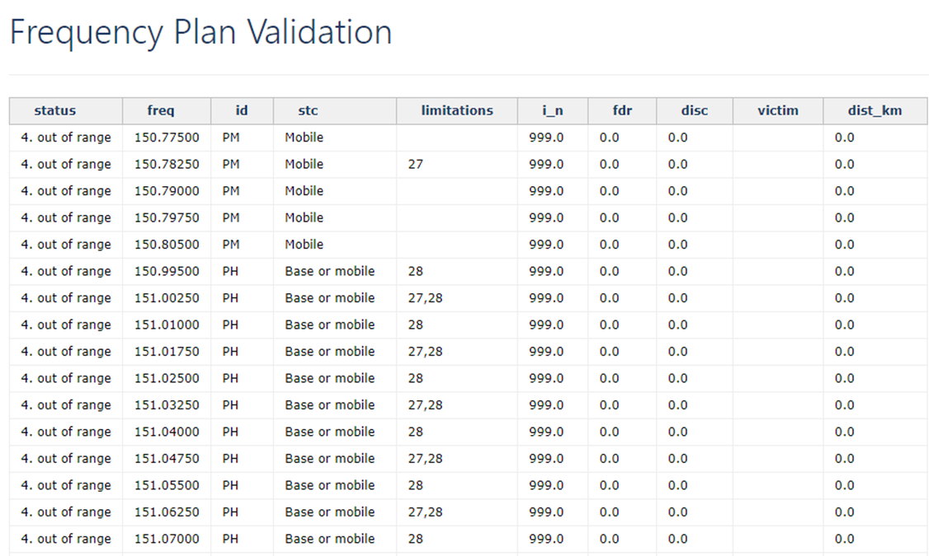
Frequency Nomination

Slide 30
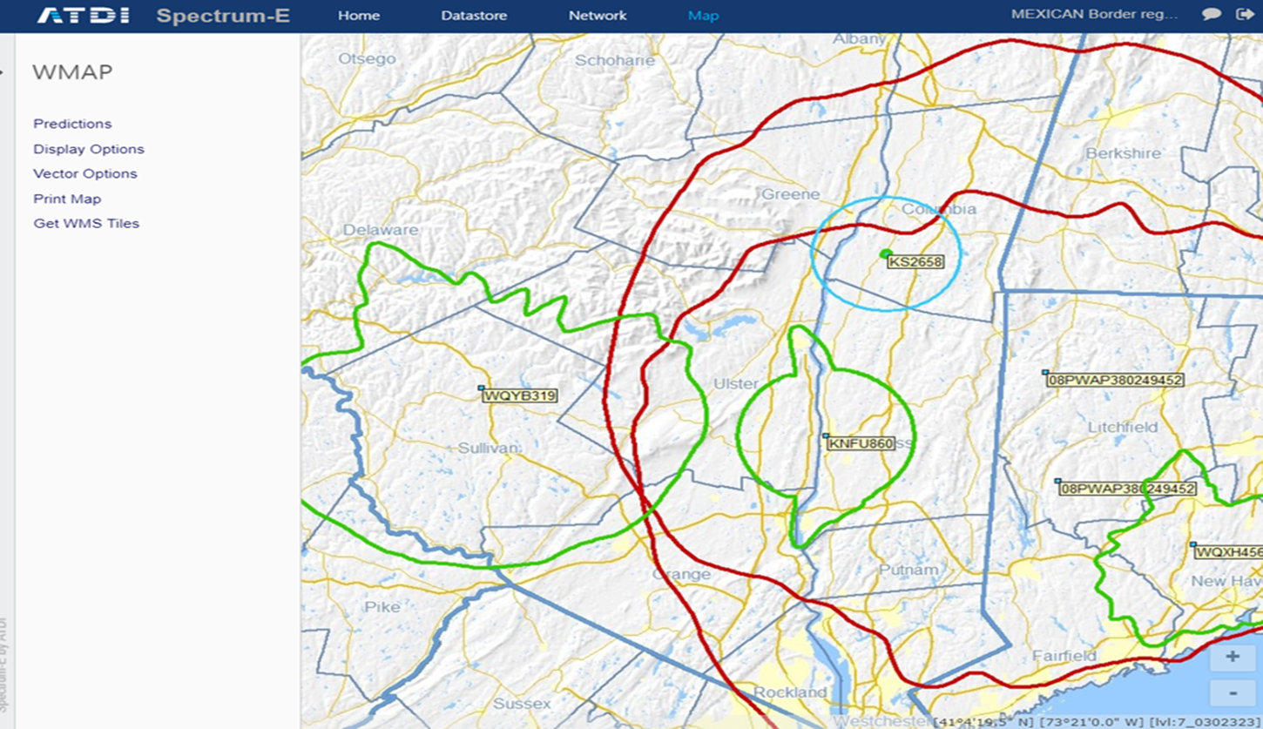
Map

Slide 31
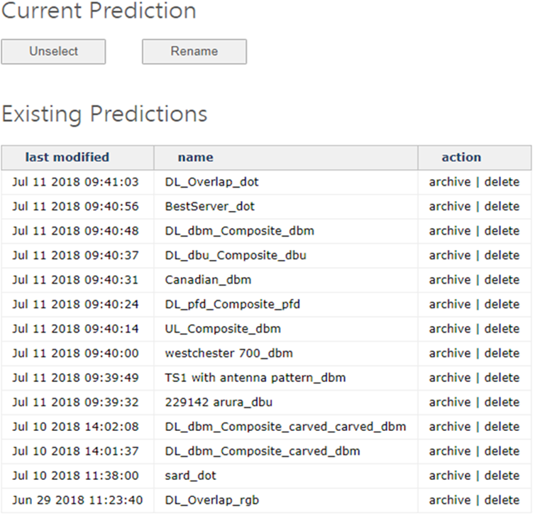
Prediction
When a coverage is generated and overlaid on the map, the user has the ability to modify the appearance of the coverage to suit his needs.
You can change the prediction by clicking on predictions on the left menu.
You can also add new palettes on the map page

Slide 32
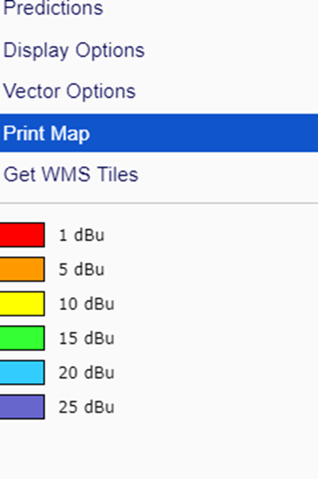
Prediction and Palettes
The palettes page cannot be seen nor modified unless a prediction is active and overlaid upon the map. The user has the ability to choose one of default palettes that may appear in the left-hand menu in the palettes page or to create a new palette according to the user’s needs
The spectrum palette allows the user to select a minimum and maximum threshold for coverage display.
For the palette to function properly, the order of the values used to define the palette must be least to greatest. After clicking Update, the palette comes into effect.
The current palette appears at the bottom of the left-hand menu. To edit the current palette, click on the palette in the menu. To access further palettes or to edit another palette, click on the Palettes link in the left-hand menu to access the palettes page

Slide 33
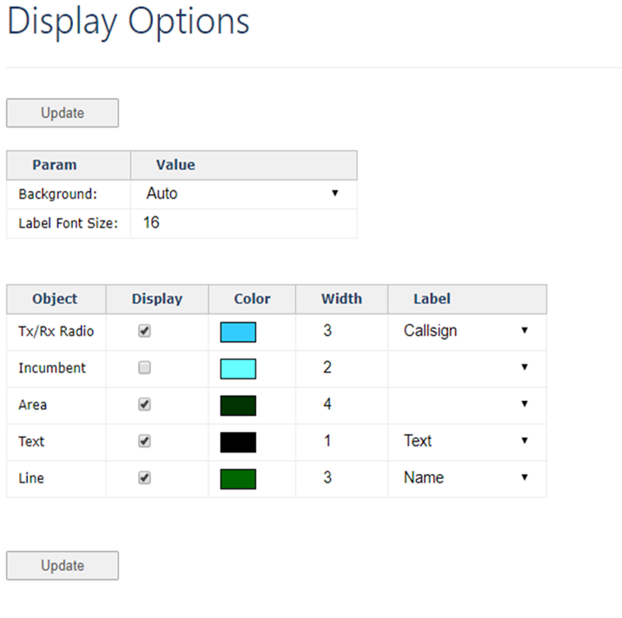
Display Options
links to the display options page where the user is able to turn the different object types on and off (whether they are displayed on the map or hidden) the color and size of the icon that denotes the object’s position on the map, and which parameter to display as a label for the item on the map (i.e. callsign, licensee, frequency, etc); also allows user to change the map background to show terrain, clutter, etc. (when available)

Slide 34
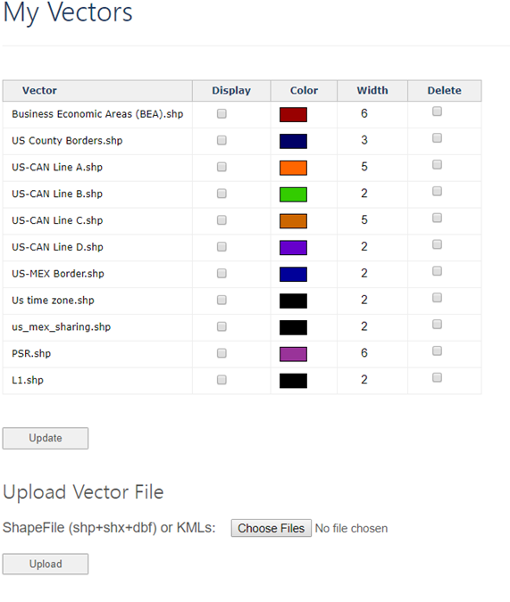
Vectors
links to the vectors page where users are able to upload Shape files, select which vectors in their vector library to display, and the color and width of the vectors when overlaid on the map

